Slide 1



Execution of Linear regression
Hadoop &
Spark ᵀᴹ
algorithm using spark on HDFS cluster on WineQuality-red dataset

Slide 2
HDFS Setup

Slide 3
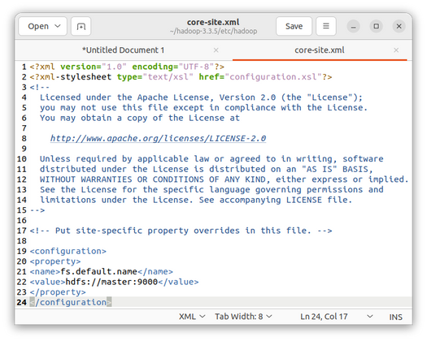
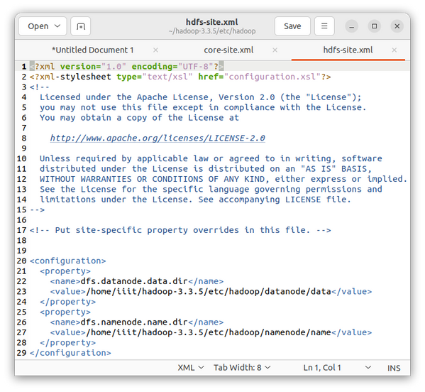
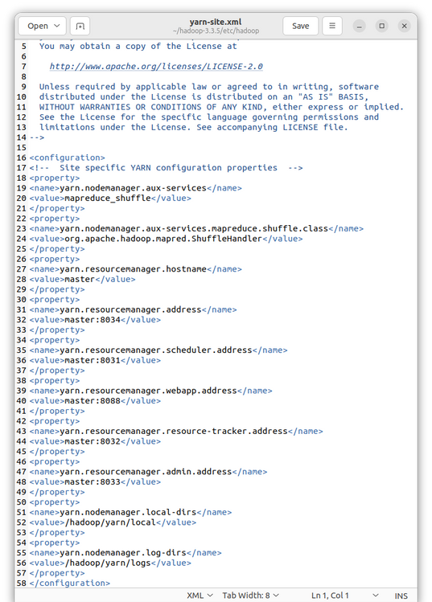
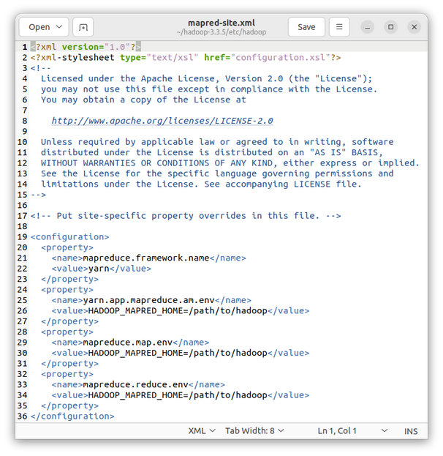
HDFS setup
Configure Hadoop:
Modify the configuration in following " .xml " files : core-site.xml
hdfs-site.xml yarn-site.xml mapred-site.xml
Setup Java path:
Setup the java path in the following files : hadoop-env.sh
yarn-env.sh mapred-env.sh
JAVA_HOME=/usr/lib/jvm/java-11-openjdk-amd64

Slide 4
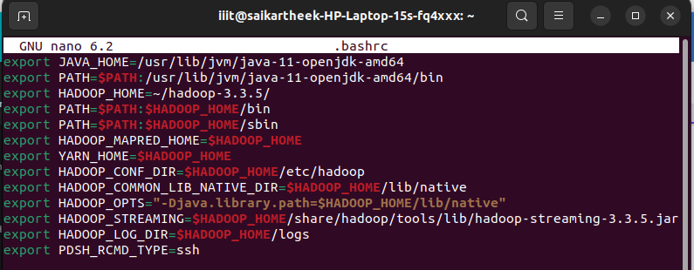
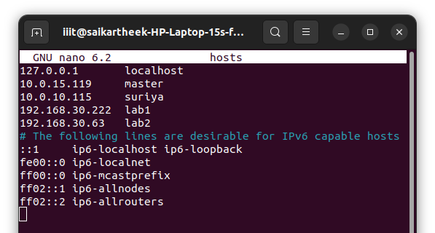
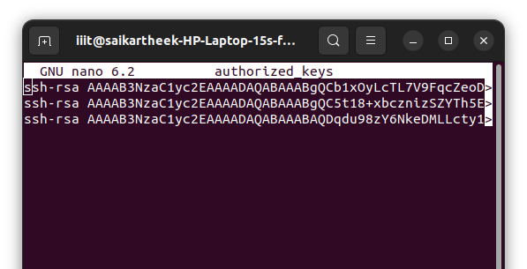
HDFS setup
Path setting in .bashrc
Add ip addresses of nodes:
Add ip address of the nodes in all the nodes under
/home/username/etc/hosts
Set up SSH:
Generate the ssh key and add all the node keys in all the nodes under
/home/username/.ssh/authorized_keys

Slide 5
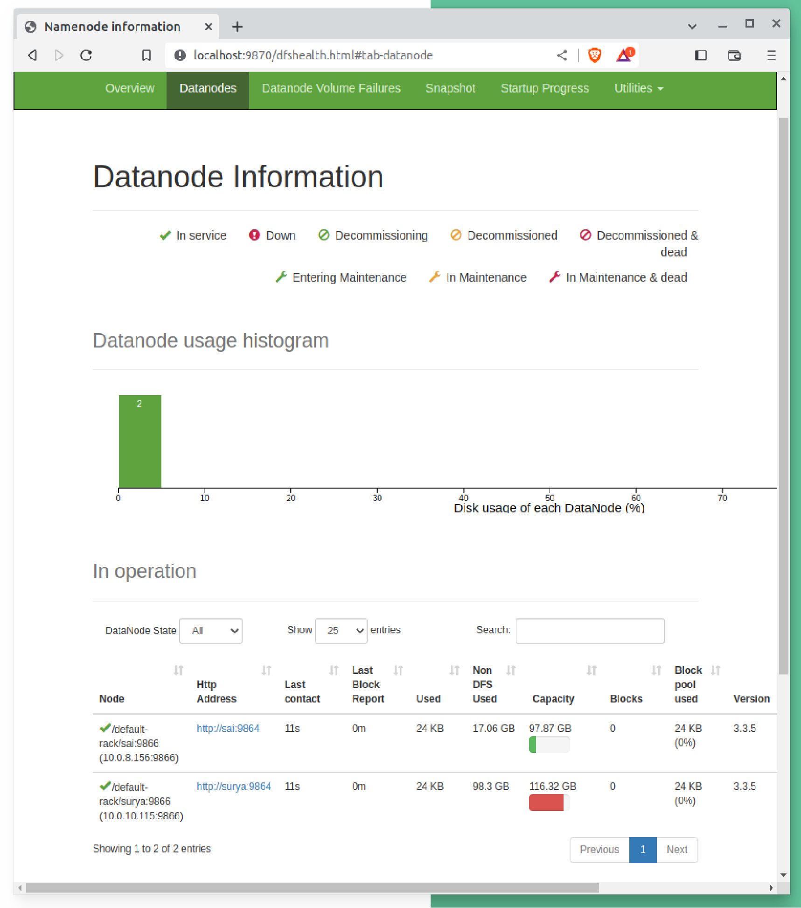
HDFS setup
Start the Hadoop daemons:
Start the Hadoop daemons on the master node using the following command:
start-all.sh
Verify the cluster:
Verify the cluster: Verify that the Hadoop cluster is running correctly by checking the Hadoop web interface, which can be accessed at localhost
http://<master-node-Ip_address>:9870

Slide 6
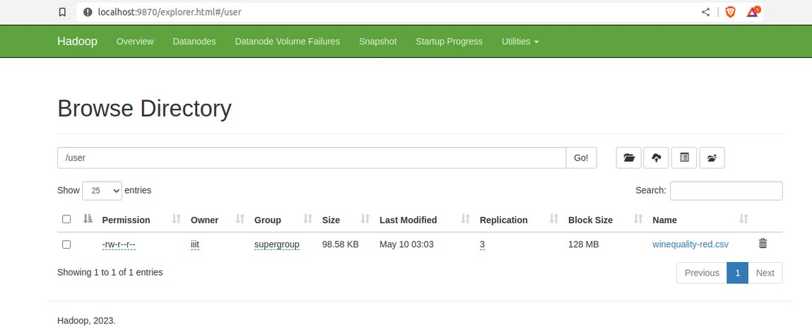
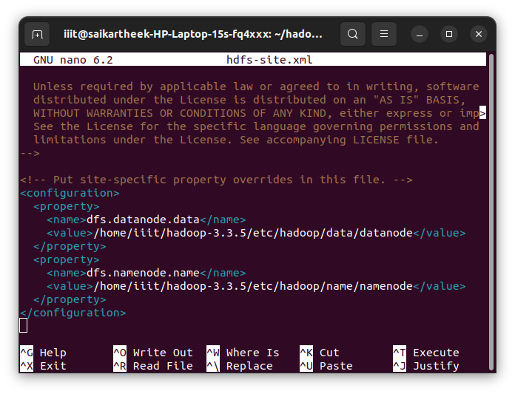

HDFS setup
Uploading dataset to hadoop cluster :
we can see the dataset stored at
http://<master-node-Ip_address>:9870
Location of dataset in Datanode :

Slide 7
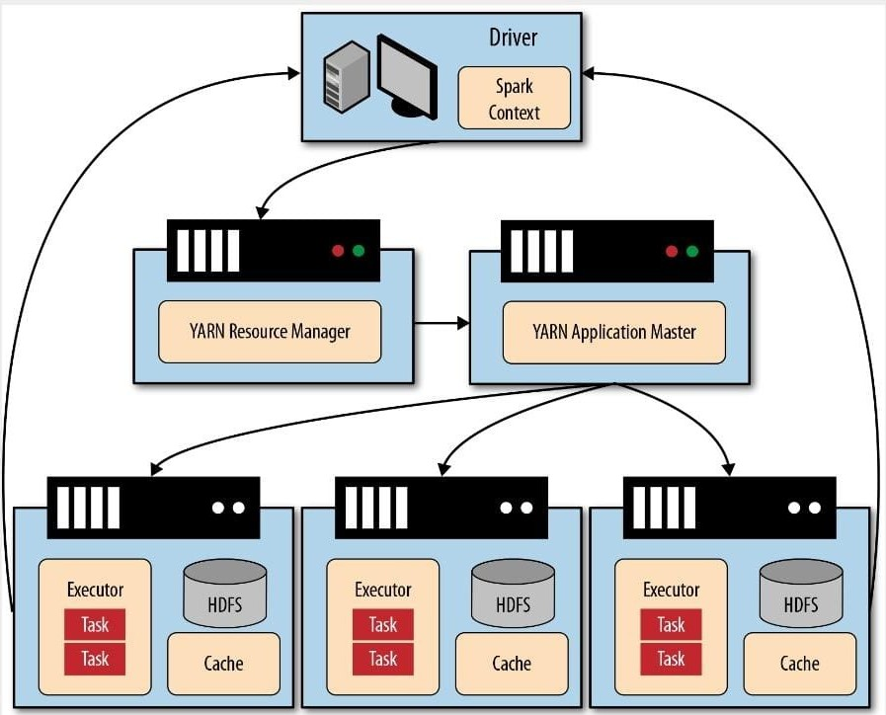
Execution of Spark on top of HDFS cluster :

Slide 8
Spark setup

Slide 9
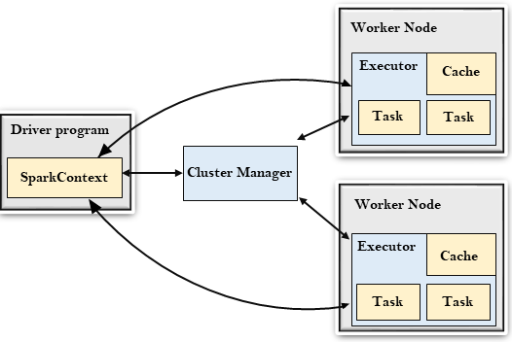
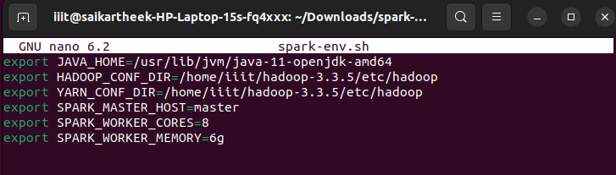
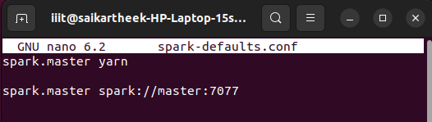
SPARK Setup
Cofigure spark:
spark-env.sh
spark-defaults.conf

Slide 10
Data Set and Algorithm

Slide 11
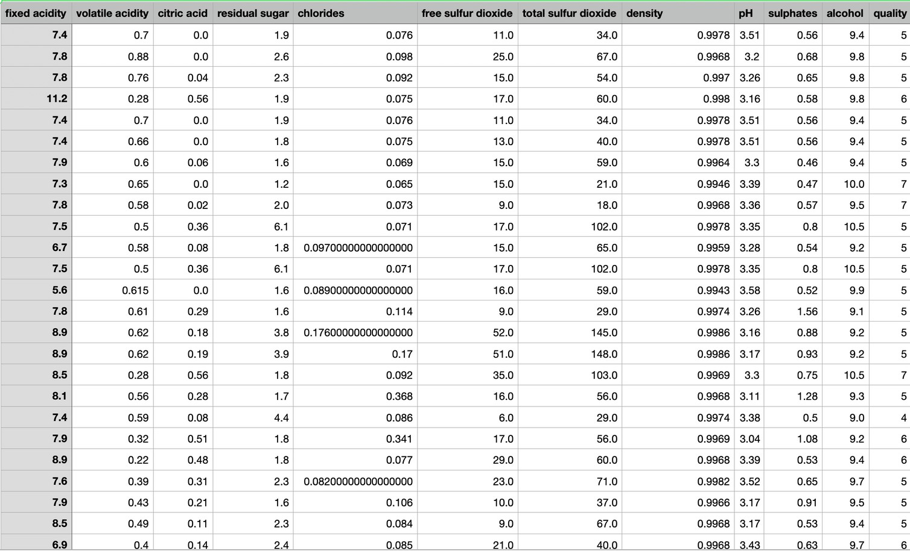
Data Set
Data Set:
The dataset used in the code is the "winequality-red.csv" file.
https://archive.ics.uci.edu/ml/machine-learning- databases/wine-quality/winequality-red.csv
The target variable to be predicted is the quality of the wine.

Slide 12
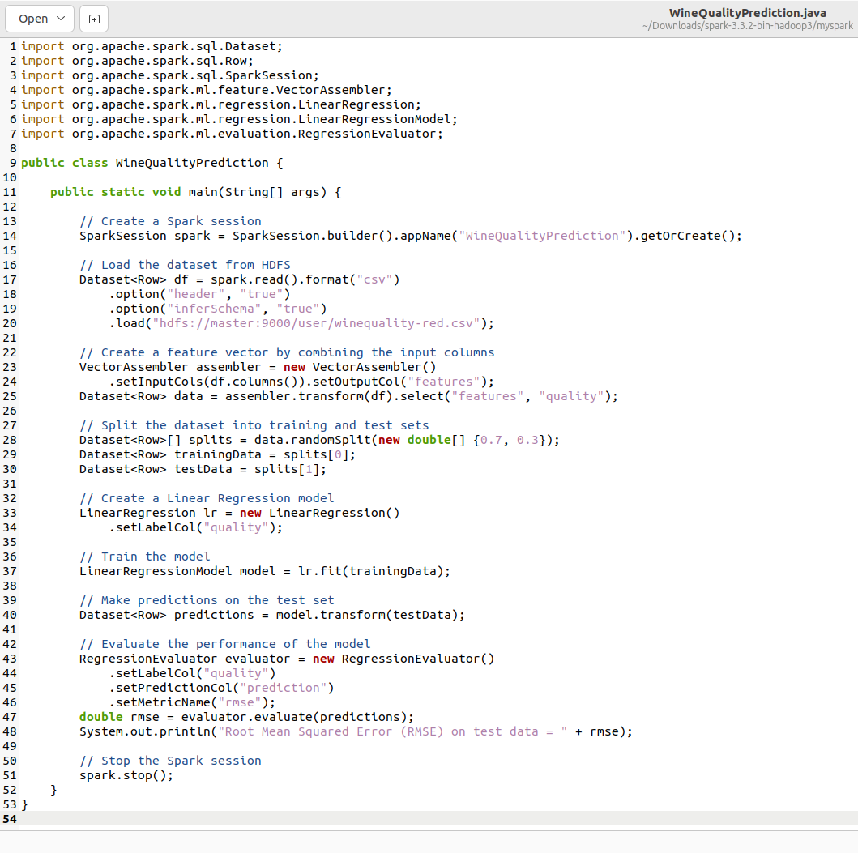
Algorithm
Algorithm :
The algorithm used in the code is Linear Regression, which is a type of supervised learning algorithm used for predicting a continuous output variable based on one or more input features.
The code includes :
Create Spark session Load the data.
Vectorize the data .
Training and testing a model. Use the model for prediction. Performance of the model.

Slide 13
Executing Algorithm using
spark on the HDFS cluster

Slide 14
Conclusion

Slide 15

GROUP MEMEMBERS
21BDS031 | Hruitn Suriya K | ( Intro and HDFS configure )
21BDS029 | Abhiram K | ( HDFS Cluster )
21BDS009 | Dhiraj BM | ( DataSet and Algorithm)
21BDS027 | Sai Kartheek Reddy | K ( About Spark and Running of Algorithm)

